Slide 1
CAPSULEFY
Cantón Fernández, Adrián
Carpio Camacho, Daniel
Fresno Aranda, Rafael
Rebollo Lobo, Pablo
Rodríguez Regidor, Juan

Slide 2

What happened to JUKEVOTE?

Slide 3

Our new idea
An online time capsule that includes a deadman switch and connects with social networks.

Slide 4

Business idea
People can create time capsules with an opening date or set up a deadman switch so that the capsule opens if they pass away.
Different functionalities depending the pricing, free version included.

Slide 5




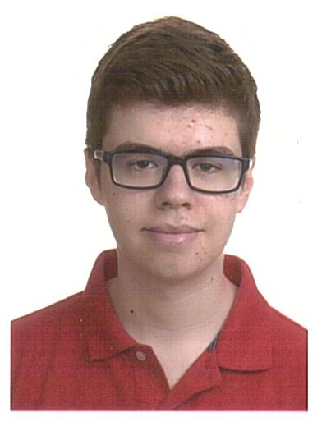
Our team
Adrián Cantón: Business management/Full-stack developer
Daniel Carpio: Analist/Frontend developer
Juan Rodríguez: Requirements engineer/Backend developer
Rafael Fresno: Backend developer/API integration
Pablo Rebollo: Backend developer/Project manager

Slide 6

Our goal

Slide 7
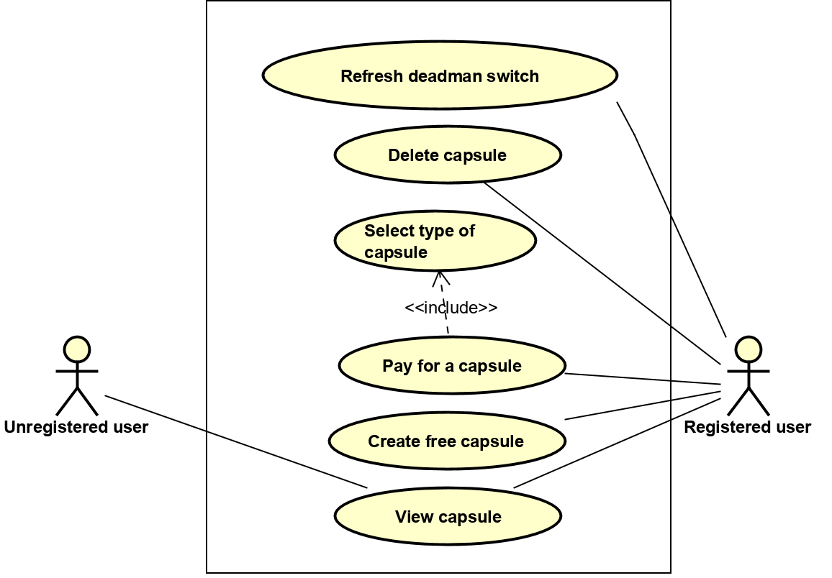
CORE REQUIREMENTS

Slide 8
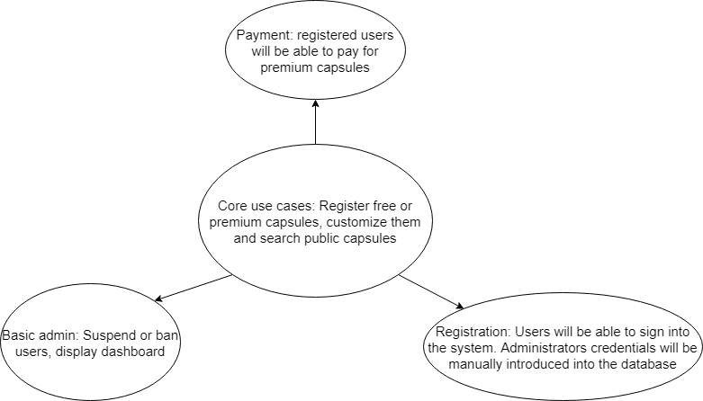
MVP

Slide 9
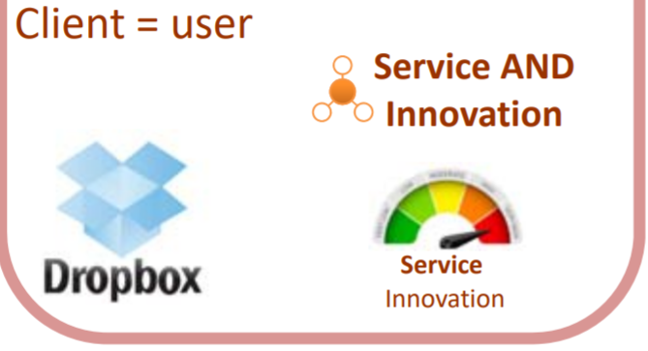
MVP CLASSIFICATION

Slide 10
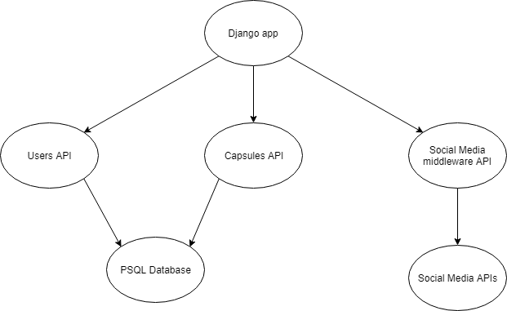
SYSTEM ARCHITECTURE

Slide 11
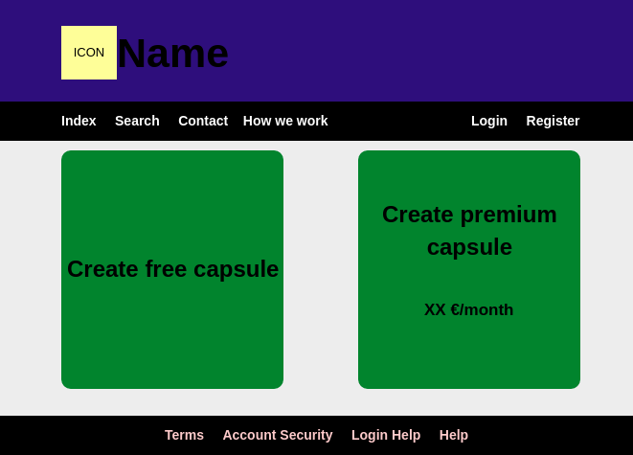
INDEX PAGE

Slide 12
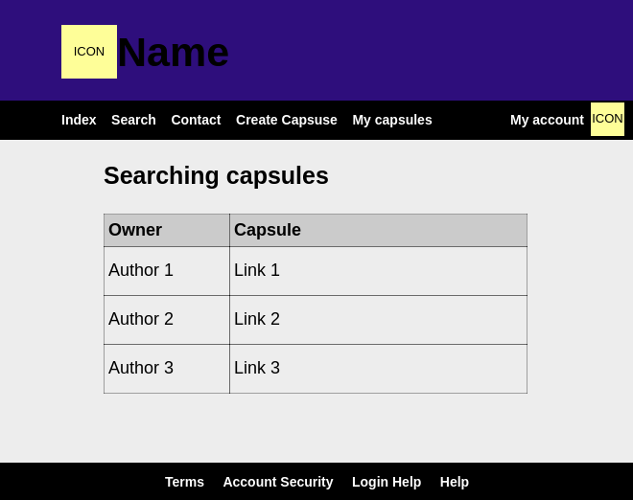
SEARCHING FUNCTION

Slide 13
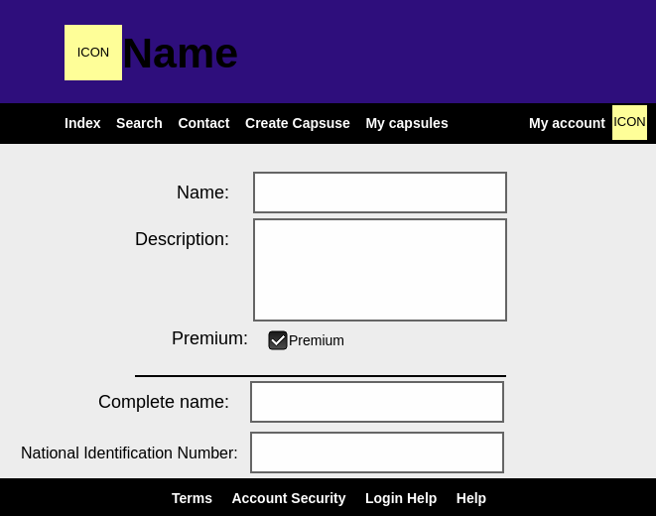
CREATING A CAPSULE

Slide 14

innovation
Communication with social media sites in order to send custom messages when the capsule opens
Deadman switch, in order to automatically open the capsule

Slide 15
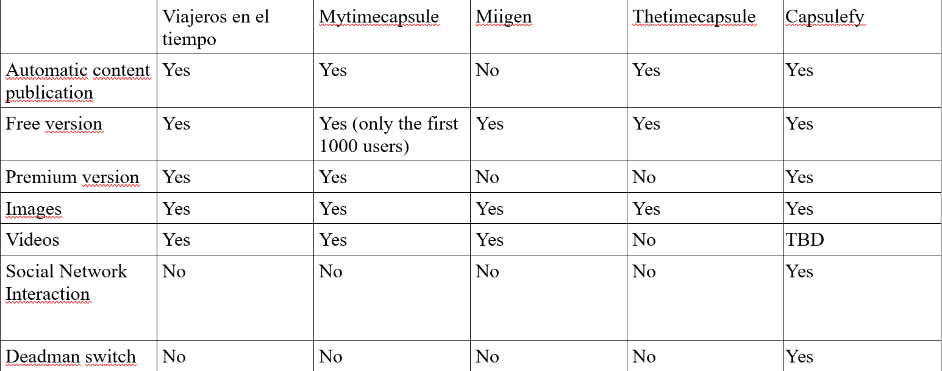
Competitors

Slide 16

Costs
Factors taken into account: Salaries, hosting, advertisement, workplace
First estimation: ~58.000 €

Slide 17
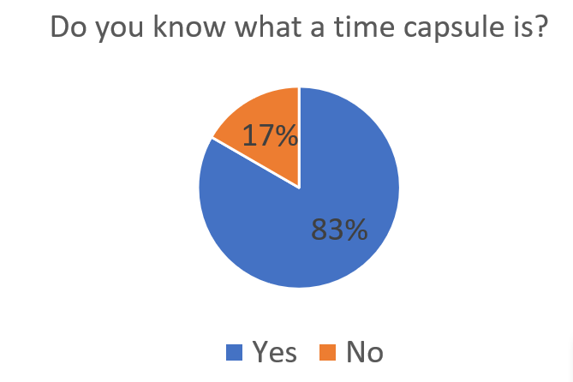
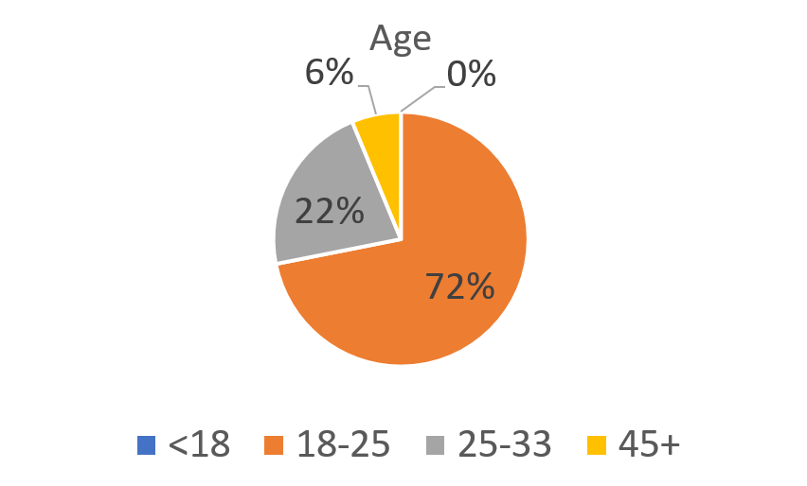
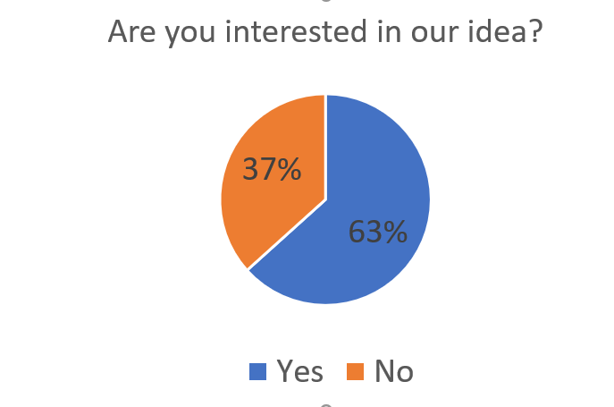
Viability study

Slide 18
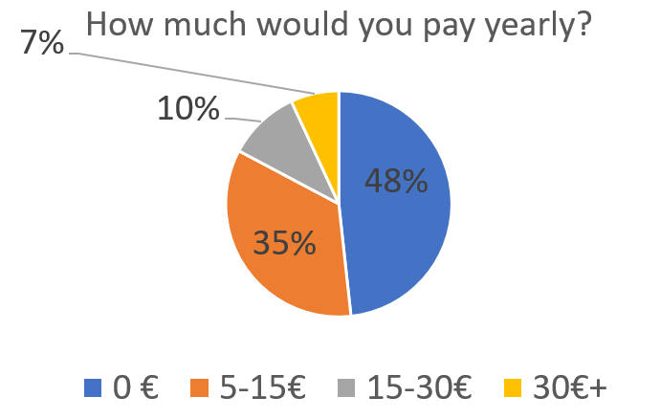
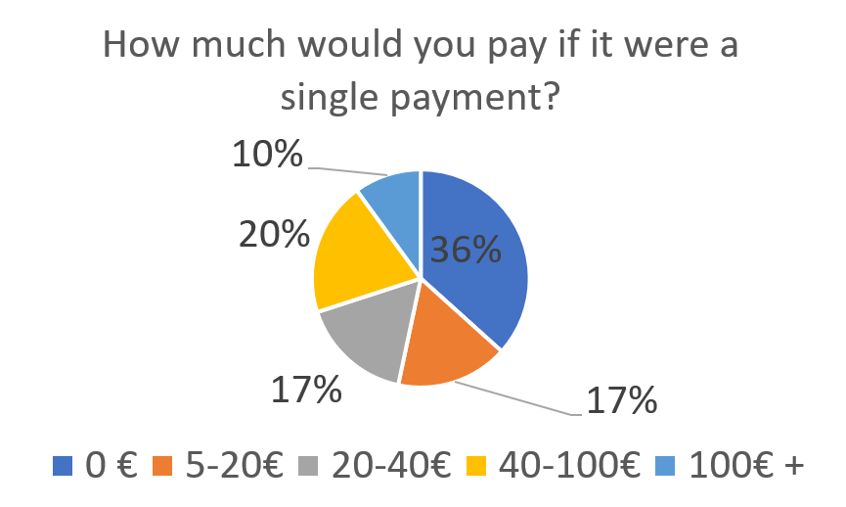
Viability study

Slide 19
OUR CONCLUSIONS
Single payment seems a better option
With a 40€ price, we would need ~1500 customers to break even
Which means we would need to reach out to ~5000 people

Slide 20
THANK YOU!

